Slide 1
US Cancer Incidence and Mortality
Cancer Rate (rate per 100,000 people): This number is represented as a percentage
Rate of cancer diagnoses
Rate of cancer deaths
Cancer Case Count
Cancer Incidence: the number of new cases diagnosed.
Cancer Mortality: the number of cancer deaths.
Cancer Trends: change over time
Cancer Rate Trends
Cancer Case Count Trends
NOTE: It is possible for the rate over time to trend down even though the counts increase during the same timespan. This is due to the increase in population.

Slide 2
US Cancer Incidence and Mortality

Slide 3
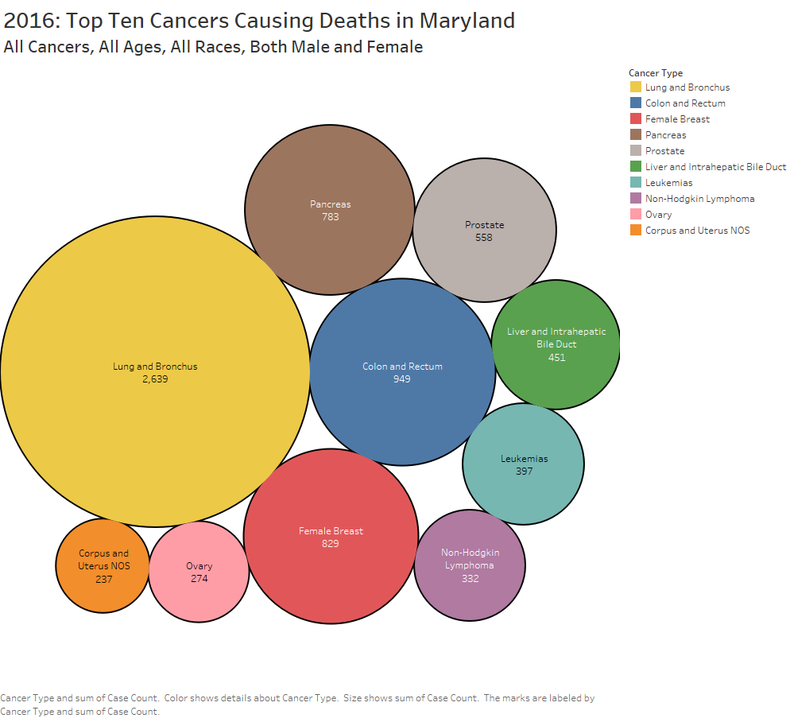
US Cancer Incidence and Mortality
Maryland
2016:

Slide 4
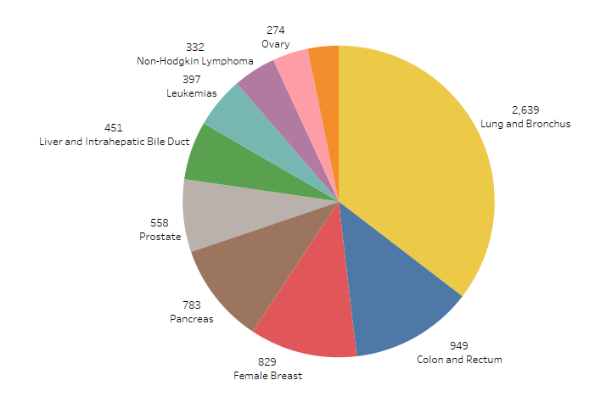
US Cancer Incidence and Mortality
Maryland

Slide 5
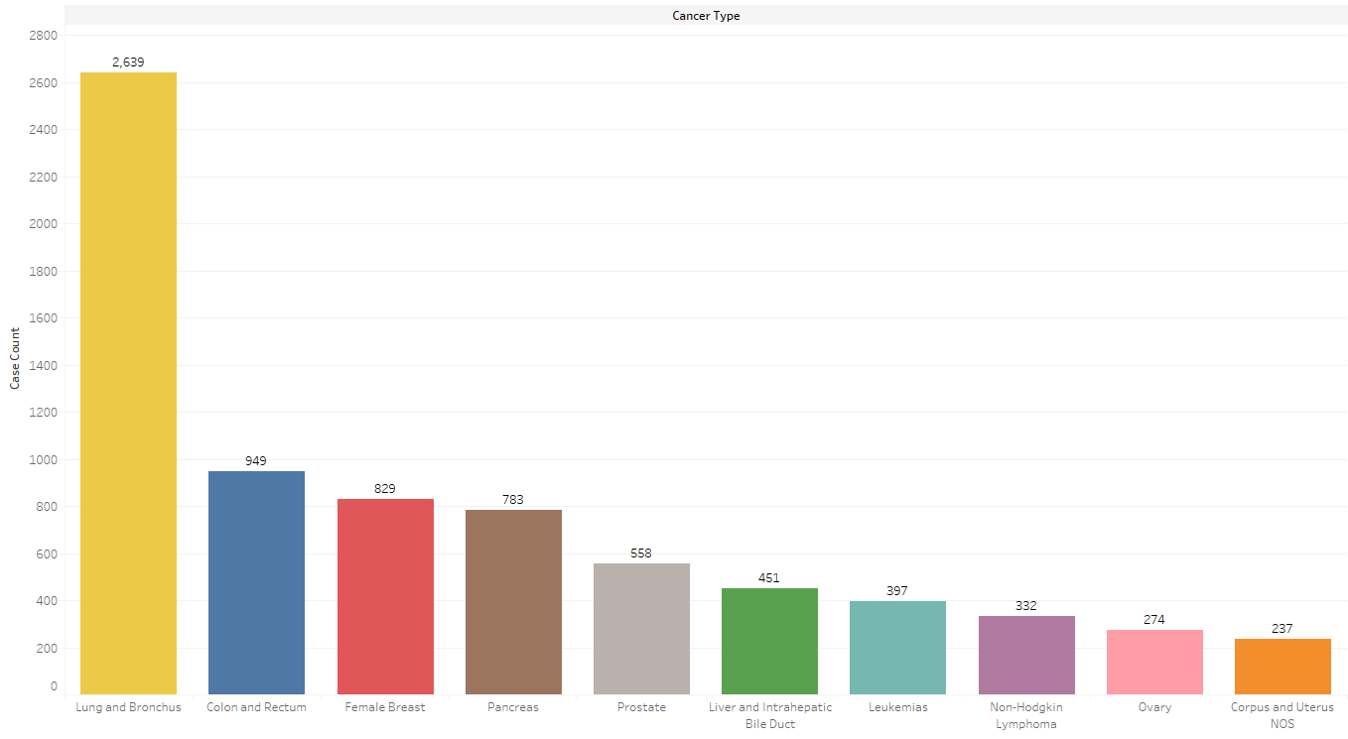
US Cancer Incidence and Mortality
Maryland

Slide 6
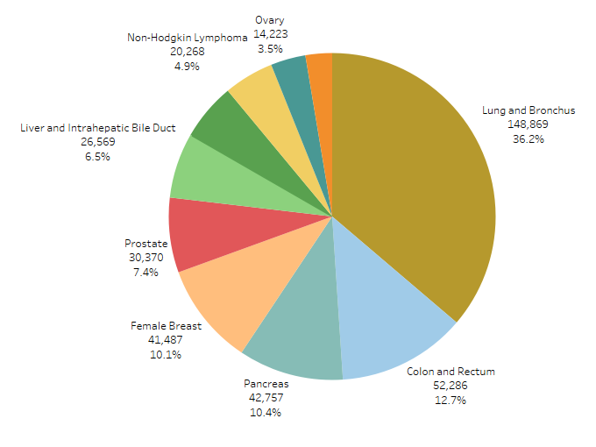
US Cancer Incidence and Mortality
US

Slide 7
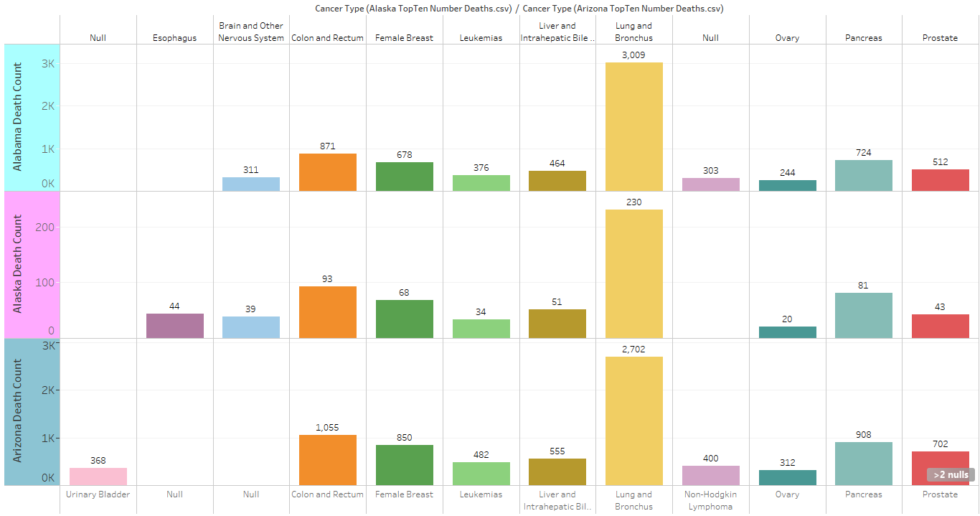
US Cancer Incidence and Mortality
Compare top 10 for Alabama, Alaska, and Arizona

